Slide 1
Grammar time Simple present

Slide 2
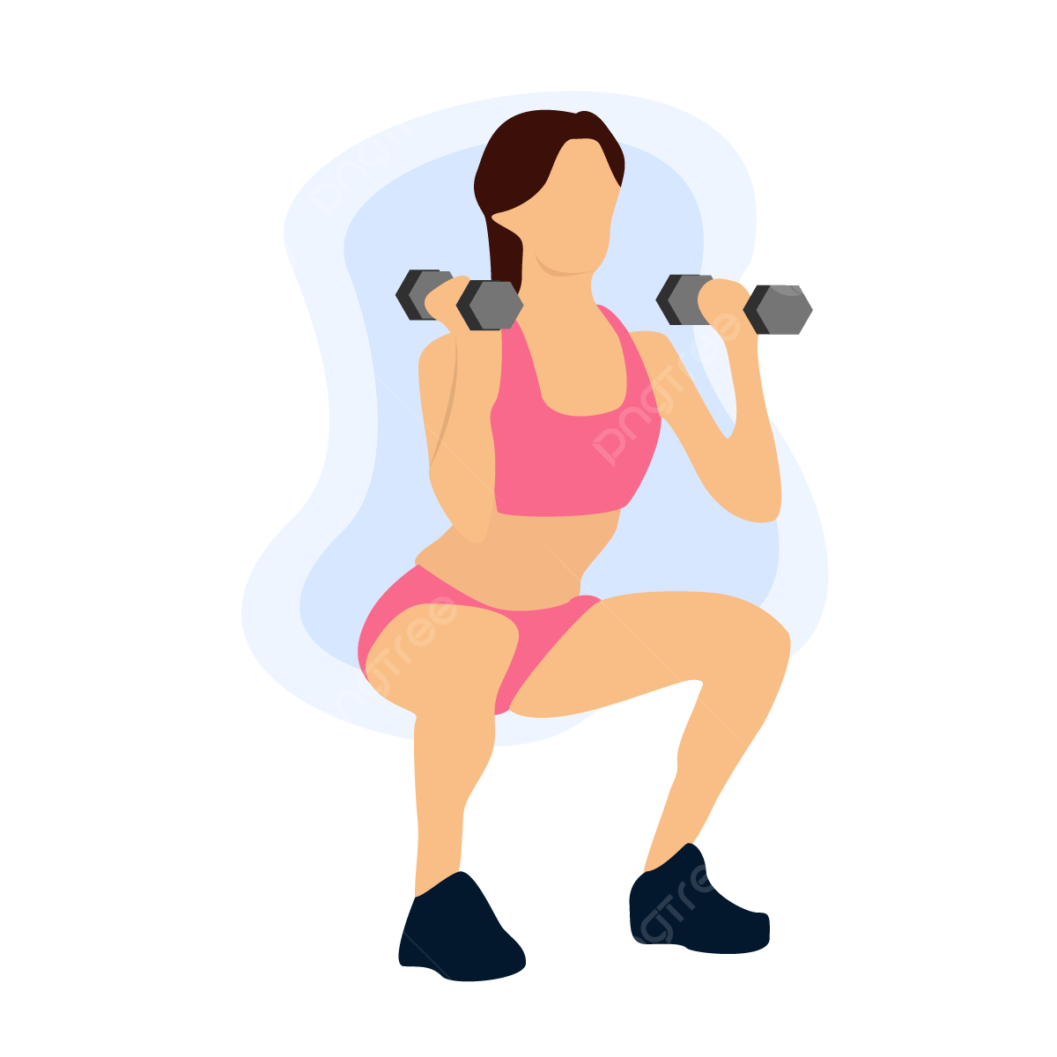
Observe as frases a seguir sobre você e aponte quais dela estão no presente:
Eu me exercito toda semana;
Eu almoço com minha família aos domingos;
Eu trabalho de segunda à sexta-feira;
Eu faço yoga regularmente;
Eu converso com a minha terapeuta uma vez
na semana.

Slide 3
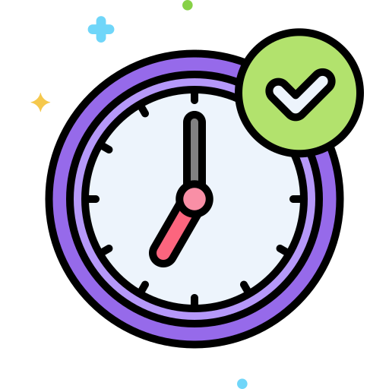
Exatamente! Todas estão no presente!

Slide 4
Agora observe as mesmas frases, porém em inglês:
I work out every week;
I have lunch with my family on Sundays;
I work from Monday to Friday;
I do yoga regularly;
I talk with my therapist once a week.
O que todas essas frases falam sobre?

Slide 5
Agora observe as mesmas frases, porém em inglês:
I work out every week;
I have lunch with my family on Sundays;
I work from Monday to Friday;
I do yoga regularly;
I talk with my therapist once a week.
O que todas essas frases falam sobre? Rotina!

Slide 6
Usamos o Simple Present para falar sobre rotina, hábitos e atividades repetitivas

Slide 7

Rotina:
I work out every week; I have lunch with my family on Sundays; I work from Monday to Friday; I do yoga regularly; I talk with my therapist once a week.

Slide 8


Hábitos e Atividades repetitivas
The bus leaves every 10 minutes.
I don’t eat meat, because I’m vegan.
Fatos
The sun rises at 6 am.
The sun falls at 6 pm.
My sister has black hair.
The cat has four legs.

Slide 9
A regra gramatical é:
Positivo
I eat pasta
You eat pasta
She eats pasta
He eats pasta
It eats pasta
We eat pasta
You eat pasta
They eat pasta

Slide 10
A regra gramatical é:
Positivo
Negativo
I eat pasta - I don’t eat pasta
You eat pasta - You don’t eat pasta
She eats pasta - She doesn’t eat pasta
He eats pasta - He doesn’t eat pasta
It eats pasta - It doesn’t eat pasta
We eat pasta - We don’t eat pasta
You eat pasta - You don’t eat pasta
They eat pasta - They don’t eat pasta

Slide 11
A regra gramatical é:
Positivo
Negativo
Pergunta
I eat pasta - I don’t eat pasta - Do I eat pasta?
You eat pasta - You don’t eat pasta - Do you eat pasta?
She eats pasta - She doesn’t eat pasta - Does she eat pasta?
He eats pasta - He doesn’t eat pasta - Does he eat pasta?
It eats pasta - It doesn’t eat pasta - Does it eat pasta?
We eat pasta - We don’t eat pasta - Do we eat pasta?
You eat pasta - You don’t eat pasta - Do you eat pasta?
They eat pasta - They don’t eat pasta - Do they eat pasta?

Slide 12
A regra gramatical é:
Positivo
Negativo
Pergunta
I eat pasta - I don’t eat pasta - Do I eat pasta?
You eat pasta - You don’t eat pasta - Do you eat pasta?
She eats pasta - She doesn’t eat pasta - Does she eat pasta?
He eats pasta - He doesn’t eat pasta - Does he eat pasta?
It eats pasta - It doesn’t eat pasta - Does it eat pasta?
We eat pasta - We don’t eat pasta - Do we eat pasta?
You eat pasta - You don’t eat pasta - Do you eat pasta?
They eat pasta - They don’t eat pasta - Do they eat pasta?

Slide 13

Now let’s practice!

